Slide 1
CAF-RRT*
A 2D Path Planning Algorithm Based on Circular Arc Fillet Method
Jonathan L Crespo
Gaurav Upadhyay
Naga Kambhampati

Slide 2
Content
Introduction
Algorithm
Simulation
Results
Problems Faced
Future Work
Conclusion

Slide 3
Introduction
CAF-RRT* is an improved algorithm introduced in 2022 based on previous variants of the original sample-based known as Rapidly-exploring Random Trees (RRT) method.
The implementation, simulation and metrics obtained by the creation of two scenarios for robot path planning are presented with challenges & improvements ahead.

Slide 4
Algorithm
Bidirectional RRT
Smoothing by Circular Arc Fillet
Quick-RRT*
CAF-RRT*
Optimization

Slide 5
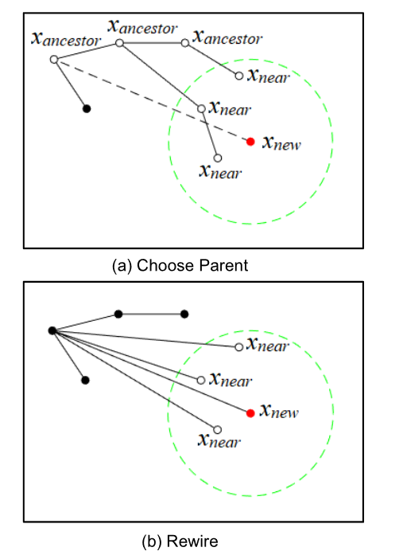
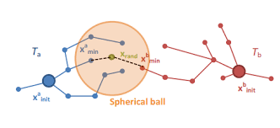
Quick RRT*
Bidirectional RRT
https://encrypted-tbn0.gstatic.com/images?q=tbn:ANd9GcSGvXwLrWolvGDa1z3R3S77lsBKhXYtLbcI1EXT3B-30w&s

Slide 6
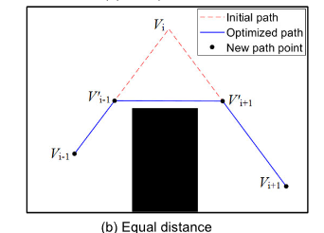
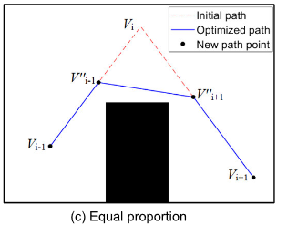
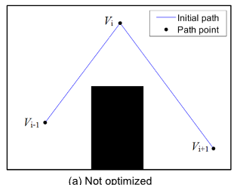


Optimize Equal distance
Optimize Equal proportion
$$∆e$$
$$p∈\left\{0,1\right\}$$

Slide 7
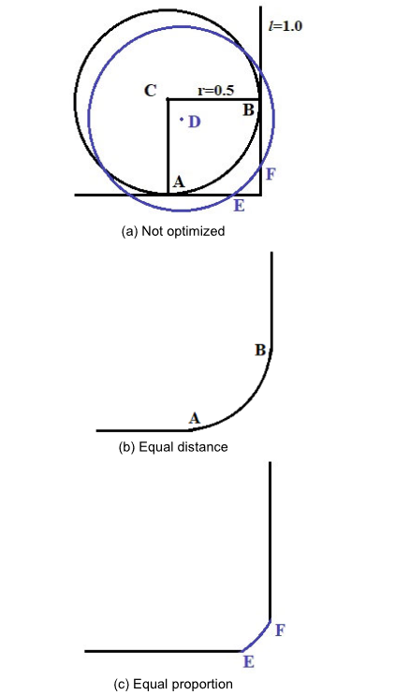
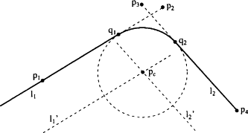
Smooth intersections by Circular Arc Fillet Method
w smoothing factor >1
https://ars.els-cdn.com/content/image/3-s2.0-B9780080507552500440-f35-01-9780080507552.gif

Slide 8
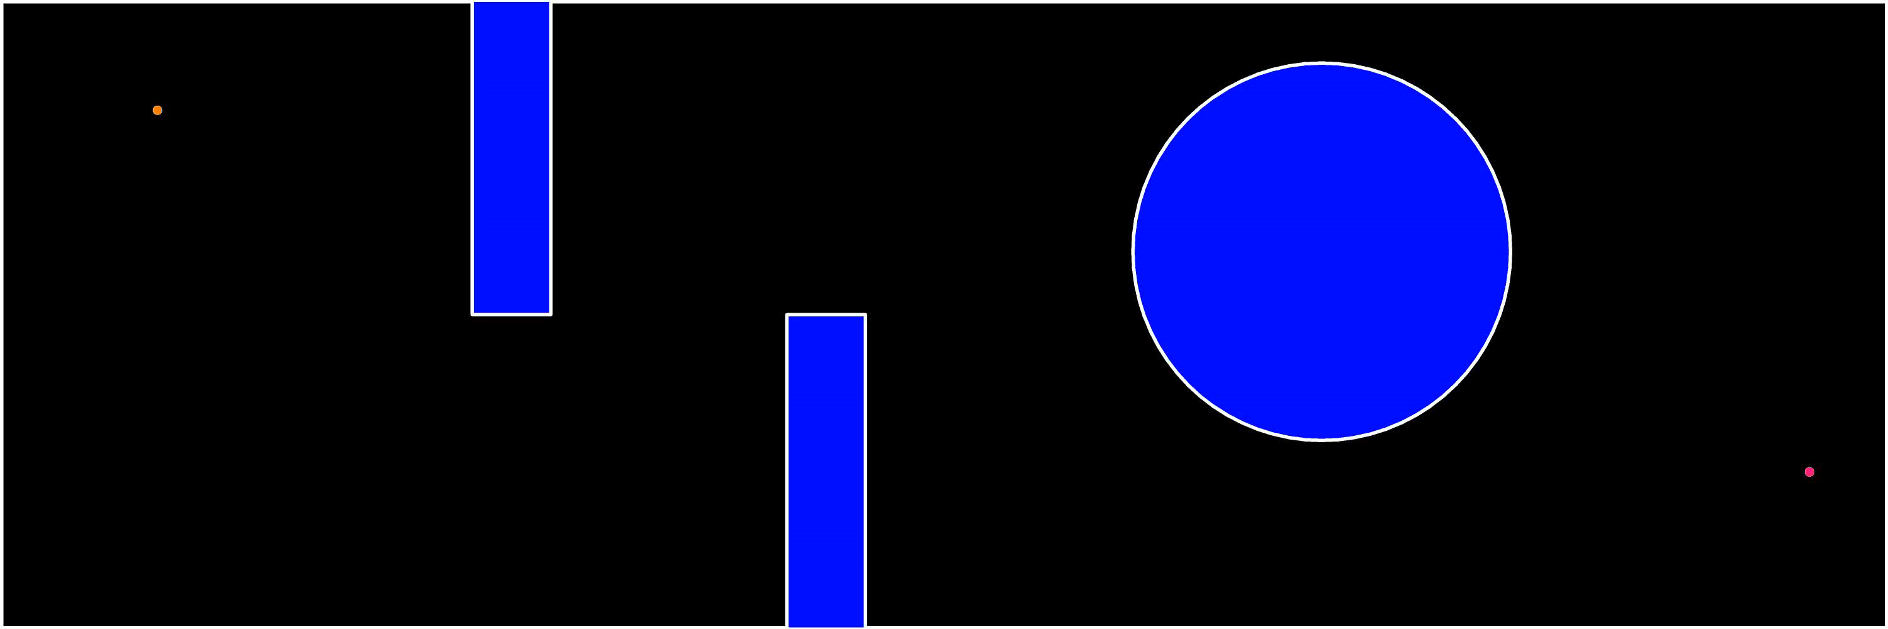
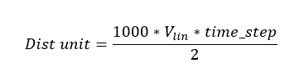
Simulation
Considering turtlebot3 2D Dist Unit = 0.25, $∆e$=10, p= 0.03
Default depth for quick RRT* was 2 in all cases

Slide 9
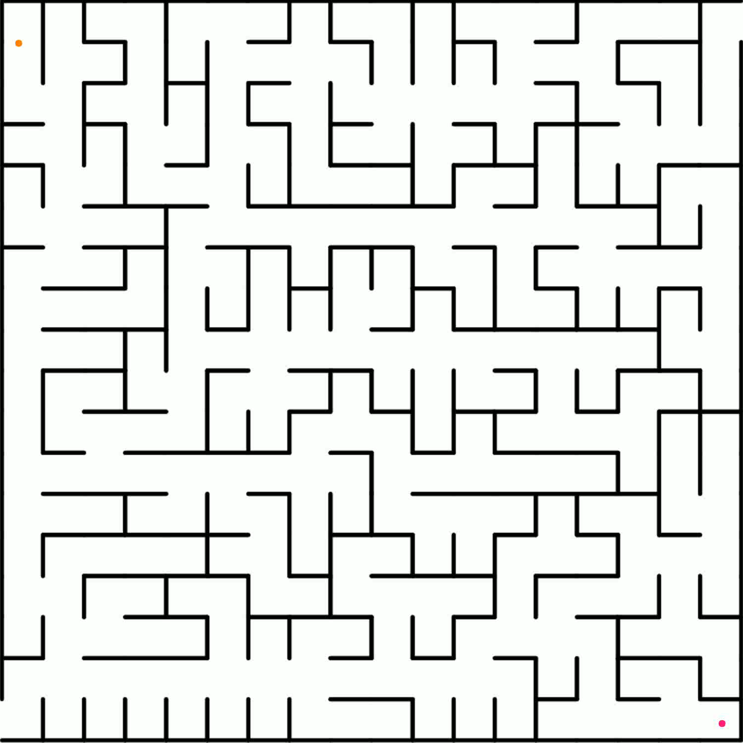
maze-tough
Robot as point, Dist Unit = 0.1, $∆e$= 5, p= 0.03

Slide 10
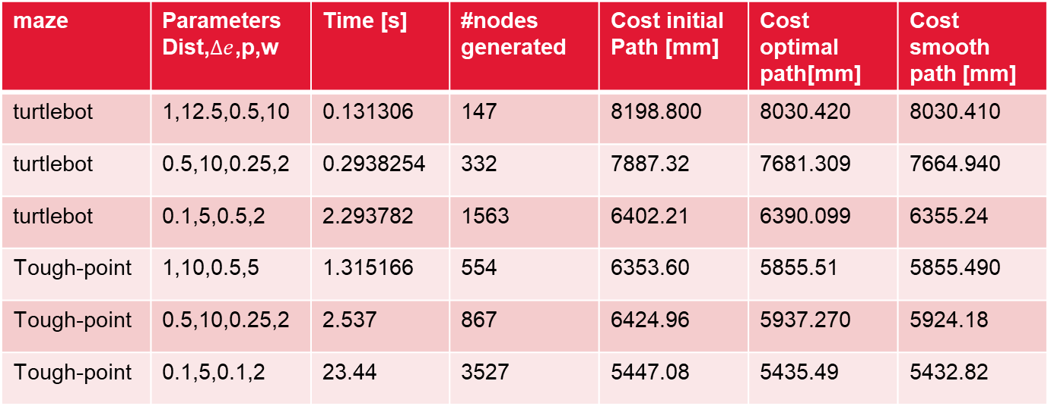
Results
maze | Parameters Dist,$∆e$,p,w | Time [s] | #nodes generated | Cost initial Path [mm] | Cost optimal path[mm] | Cost smooth path [mm]
turtlebot | 1,12.5,0.5,10 | 0.131306 | 147 | 8198.800 | 8030.420 | 8030.410
turtlebot | 0.5,10,0.25,2 | 0.2938254 | 332 | 7887.32 | 7681.309 | 7664.940
turtlebot | 0.1,5,0.5,2 | 2.293782 | 1563 | 6402.21 | 6390.099 | 6355.24
Tough-point | 1,10,0.5,5 | 1.315166 | 554 | 6353.60 | 5855.51 | 5855.490
Tough-point | 0.5,10,0.25,2 | 2.537 | 867 | 6424.96 | 5937.270 | 5924.18
Tough-point | 0.1,5,0.1,2 | 23.44 | 3527 | 5447.08 | 5435.49 | 5432.82
Using further away locations for start and goal in the mazes*

Slide 11
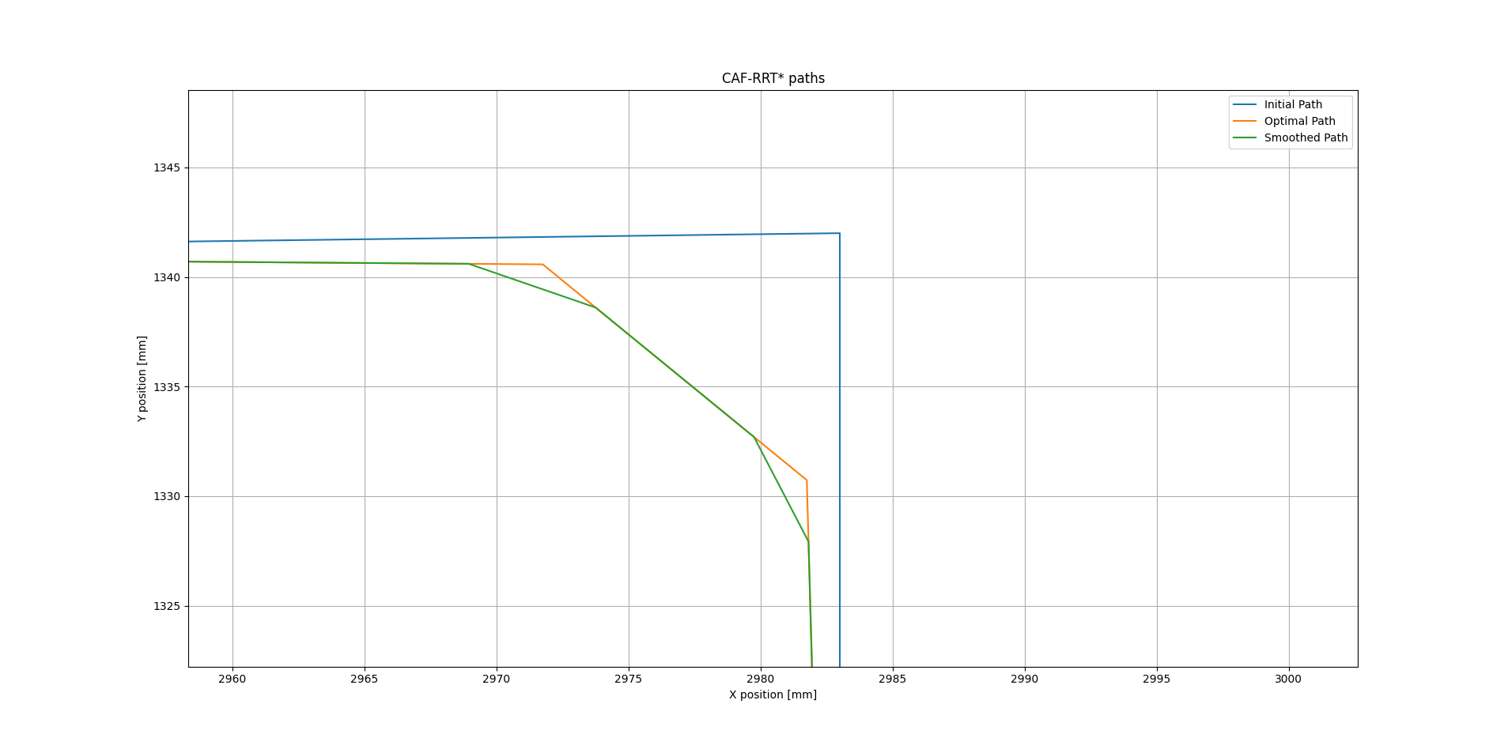
Reduction of costs is most affected by optimization that is about 3-8%.
Smoothing contributes less than 1% in cost reduction

Slide 12
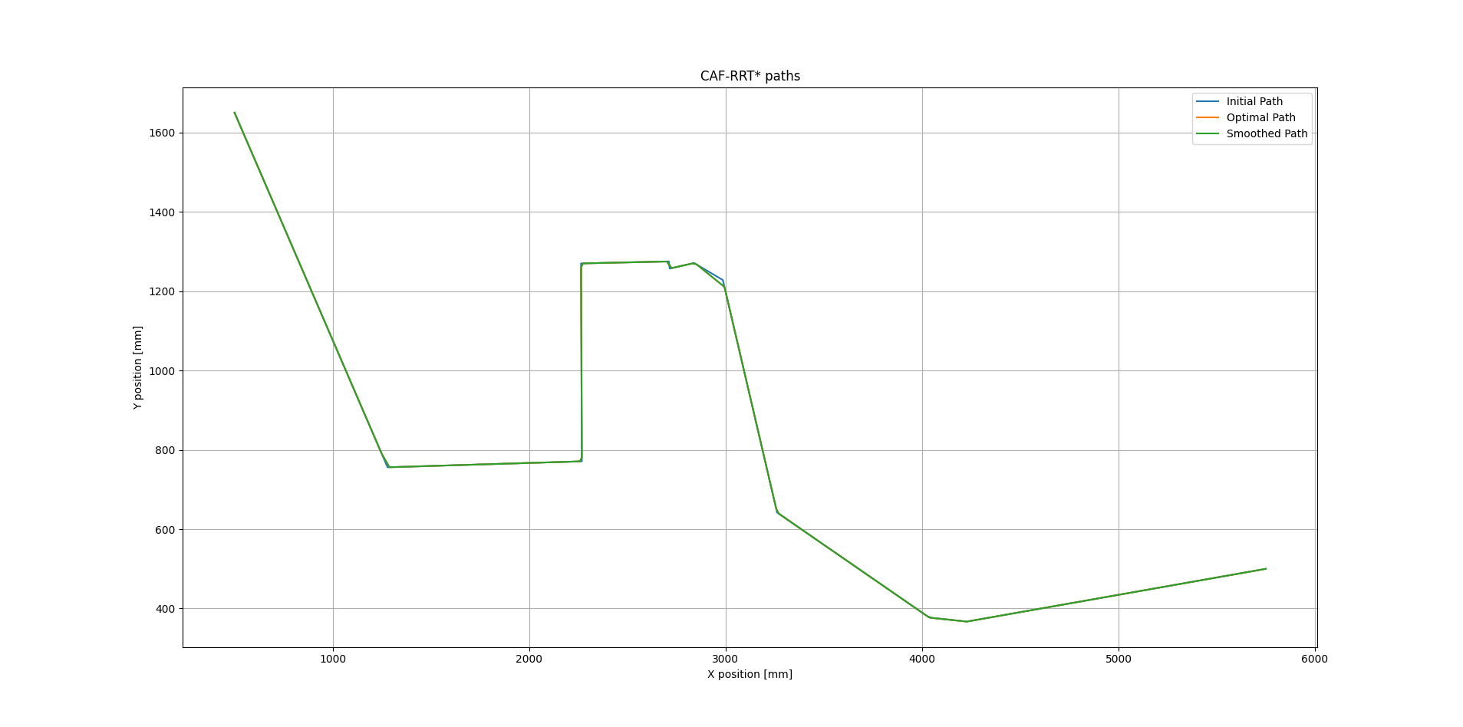
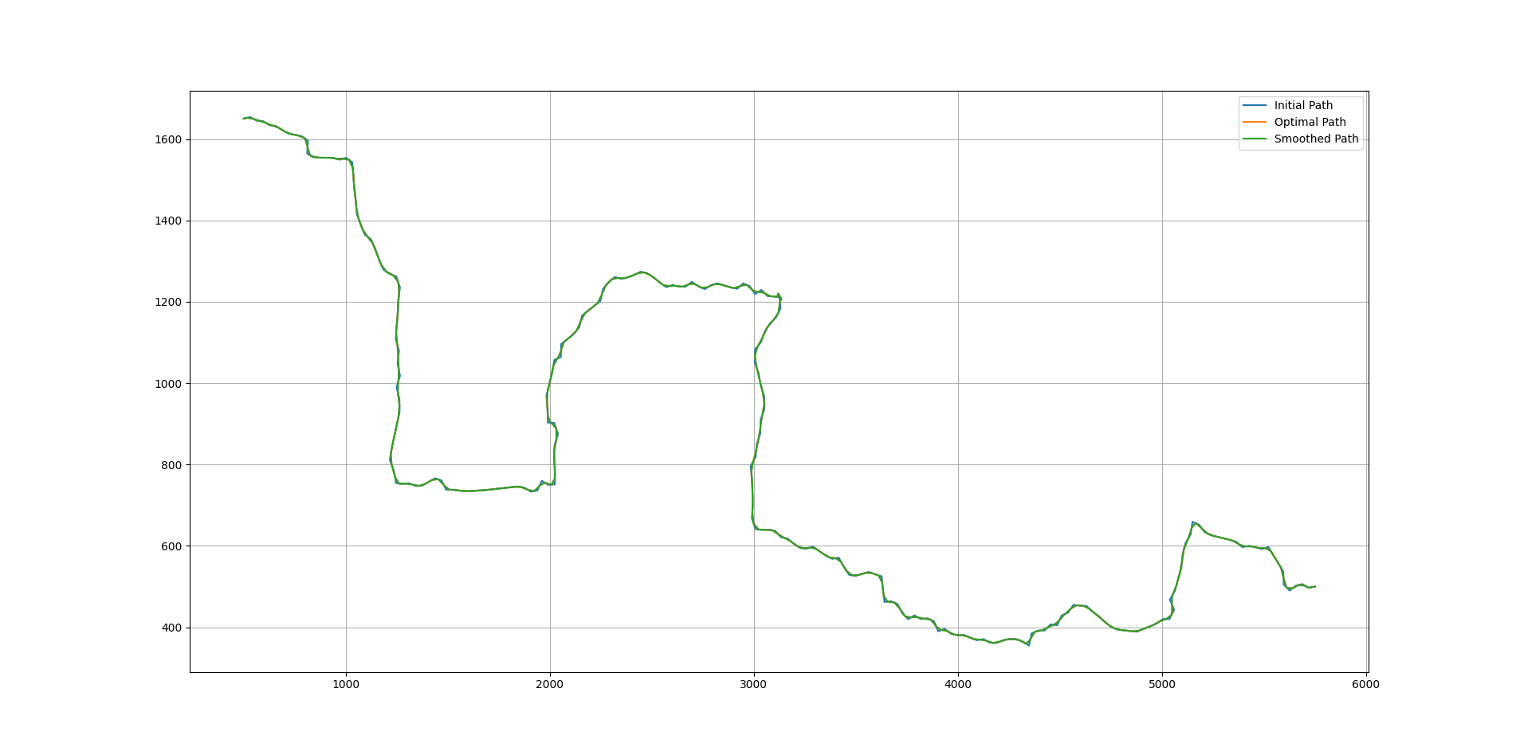
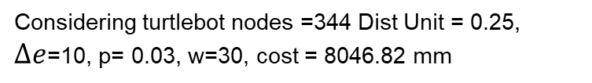
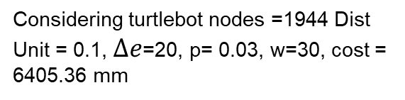
↓ distance
↑ nodes
↓ cost
↑ time
↑ sharper
↓ effect opt & smooth
Considering turtlebot nodes =1944 Dist Unit = 0.1, $∆e$=20, p= 0.03, w=30, cost = 6405.36 mm
Considering turtlebot nodes =344 Dist Unit = 0.25, $∆e$=10, p= 0.03, w=30, cost = 8046.82 mm

Slide 13
Problems Faced
Tuning of parameters and comprehension of their effects. Certain values lead to non desirable solutions.
Full smoothing application of the CAF method. Pseudo-smoothing implementation was done.
Check collision strategy required more iterations than expected, using interpolation.
Animation fail if frame rate is high.

Slide 14
Future work
Improve CAF current smoothing implementation.
Better strategy for check collision
Be able to use a robot with dimensions no matter the given maze.
Adaptative calculations according with information of map.
Consider multi robot agents.
Use of ML as reinforce or deep networks.
Extend problem to 3D space.

Slide 15
Conclusions
CAF-RRT* straightens the total path considering collision and plus smooth it for minimize harsh transitions.
Although solution is not deterministic, it gives a faster and feasible solution than graph traversal algorithms used before.
Efficient, optimal considering safety and improvement of path quality is directly related of a well tuned execution for the application.

Slide 16
Bibliography
WANG, B., JU1, D., XU, F., FENG, C., & XUN, G. (2022, December). CAF-RRT∗: A 2D Path Planning Algorithm Based on Circular Arc Fillet Method. IEEE SYSTEMS, MAN AND CYBERNETICS SOCIETY SECTION, 127168-127181. Retrieved from https://ieeexplore.ieee.org/document/9969595 Images of paper were used
Jeong, I.-B., Lee, S.-J., & Kim, J.-H. (2019, January). Quick-RRT∗: Triangular inequality-based implementation of RRT∗ with improved initial solution and convergence rate. Expert Systems with Applications, 82-90. Retrieved from https://www.sciencedirect.com/science/article/abs/pii/S0957417419300326
LaValle, S. M. (2006). Planning Algorithms . Cambridge University Press. Retrieved from https://msl.cs.uiuc.edu/planning/bookbig.pdf
Miller, R. (1992). JOINING TWO LINES WITH A CIRCULAR ARC FILLET. Graphics Gems III (IBM Version), 193-198. Retrieved from https://www.sciencedirect.com/science/article/abs/pii/B9780080507552500440

